Slide 1
Car Accident Severity Prediction
Background: Annual Global Road Crash Statistics · Approximately 1.35 million people die in road crashes annually, on average 3,700 people lose their lives every day on the roads. · An additional 20–50 million suffer non-fatal injuries, often resulting in long-term disabilities. · More than half of all road traffic deaths occur among vulnerable road users — pedestrians, cyclists, and motorcyclists. · Road traffic injuries are the leading cause of death among young people aged 5–29. Young adults aged 15–44 account for more than half of all road deaths. · On average, road crashes cost countries 3% of their gross domestic product.
Annual United States Road Crash Statistics · More than 38,000 people die annually in crashes on U.S. roadways. The U.S. traffic fatality rate is 12.4 deaths per 100,000 inhabitants. · An additional 4.4 million are injured seriously enough to require medical attention. · Road crashes are the leading cause of death in the U.S. for people aged 1–54. · The economic and societal impact of road crashes costs U.S. citizens $871 billion. · Road crashes cost the U.S. more than $380 million in direct medical costs. · The U.S. suffers the most road crash deaths of any high-income country, about 50% higher than similar countries in Western Europe, Canada, Australia and Japan.

Slide 2
Target Audience:
The Seattle administration: By targeting areas prone to areas to speeding accidents, interventions such as speed bumps, stop signs etc. can be put in place to reduce accidents.
Car Insurance Companies: Areas where parked cars are prone to getting damaged. Owners in those localities may be asked to pay more premium on their car insurance.
Health-care workers and emergency services in Seattle: By having enough data on the crash one can predict the severity and therefore take action more quickly potentially saving lives. Practical Uses of the Model: · Speed reduction measures in areas prone to accidents due to speeding · More accurate calculation of risk premiums by Car Insurance companies · Proactive actions taken by Health-care by predicting severity of the accident.
Future Use Case: AI in self-driving cars can use such models to assess risk of accidents and change routes or ask the driver to be vigilant during auto-pilot

Slide 3
Data:
The Accident data (provided by seattle.gov: https://s3.us.cloud-object-storage.appdomain.cloud/cf-courses-data/CognitiveClass/DP0701EN/version-2/Data-Collisions.csv ) will be used to predict the Severity of an accident given certain features https://s3.us.cloud-object-storage.appdomain.cloud/cf-courses-data/CognitiveClass/DP0701EN/version-2/Metadata.pdf. The data is for Accidents occurring in the city of Seattle from 2004 to 2020. Label = y = SEVERITYCODE (1 or 2) Severity Code 1: Injury Collision Severity Code 2: Property Damage Total Number of features in dataset: 37 Features selected after Feature Engineering: (X)

Slide 4
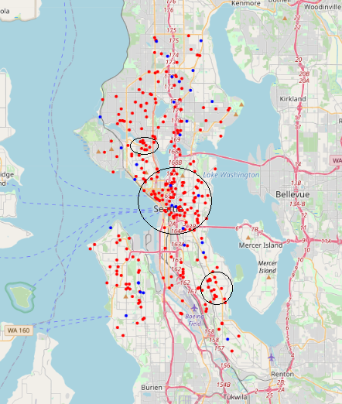
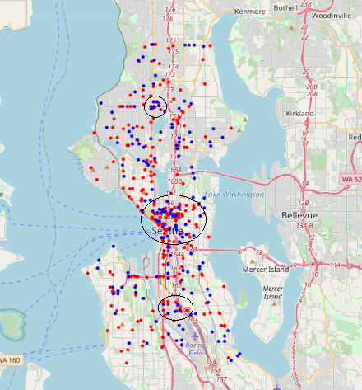
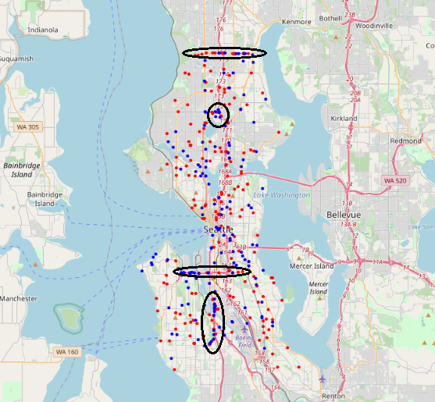
Data Analysis: · Plotting factors on the map to get density of areas where accidents were caused by the features in question: Speeding:

Slide 5
Using the following classifiers to get the prediction whether given certain attributes (features = X), the severity of the accident (labels = y)
K Nearest Neighbours
Logistic Regression
Decision Tree Classifier
XGBoost Classifier
Random Forest Classifier
Support Vector Machine

Slide 6
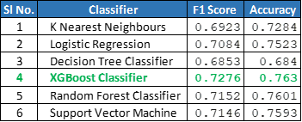
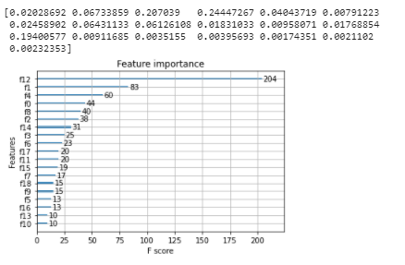
Result
The Classifier that performed the best was the XGBoost Gradient Classifier with an accuracy of 76.29% The Gradient Boost classifier predicts the Severity of the accident (Injury Collision, Property Damage Only Collision) up to ~76.3% accuracy
Feature Importance Analysis: The most important features were: I. Collision Type (f12) II. Person Count (f1) III. Vehicle Count (f4)

Slide 7
CONCLUSION
The data-set has been used to classify the severity of the accidents based on certain select features. The exploratory data analysis shows density of accidents based on geography based on Speeding, Driving Under Influence, In-attention and Hitting Parked Cars. From a machine learning standpoint. The most important features were: Collision Type, Person Count, Vehicle Count and Address Type. The Gradient Boost algorithm performed the best.

